Slide 1
Introduction to z/OS Security
Lesson 6: z/OS UNIX Security

Slide 2
It’s NOT USS
USS is a service mark of
  Ultrastrip Systems, Inc. CORPORATION
USS is a Trademark of
  LA VISION GMBH CORPORATION
USS Is a trademark of
  United States Steel Corporation

Slide 3
Objectives
At the completion of this topic the student should understand:
  The interaction between the USS Kernel and RACF
  How RACF provides security services for USS
  Different types of Security Packets
    File Security Packet
    User Security Packet
  Security related services used by the operating system

Slide 4
Key terms
InitACEE
File Security Packet
User Security Packet
OMVS Segment
UID
GID
pthread_security_np()

Slide 5
Introduction
All access control decisions for z/OS UNIX are made by RACF, unlike other UNIX systems.
In z/OS UNIX, RACF knows users by a numeric ID, called a UID. Additionally, groups the users belong to are known by group IDs (GIDs).
  For example, if everyone within a department needs to use a certain set of common files, directories, or devices, that department would be a group and have a GID.
A user's UID and GID are stored in RACF's security data base.

Slide 6
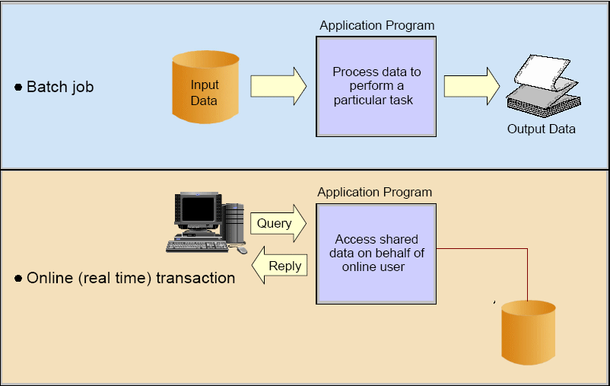
What is z/OS Unix?
The z/OS operating system contains a UNIX-like component named z/OS UNIX. The addition of z/OS UNIX has allowed the z/OS operating system to add open standard technologies to its already impressive online and batch processing capabilities.
z/OS UNIX workload may execute as either online or batch, depending on the nature of the workload. The z/OS web server, for example, runs under z/OS UNIX and is an online workload, since the HTTP requests are interactive in nature and the user is waiting for the results to be displayed within their browser.

Slide 7
What is z/OS Unix?
A partial list of technologies that have been implemented on z/OS using z/OS UNIX system services includes:
  TCP/IP and related services (telnet, ftp, smtp, etc.)
  z/OS web server
  z/OS LDAP server
  z/OS Java Development Kit (JDK)
  z/OS Java Run-time Environment (JRE)
This list of services are growing with each z/OS release

Slide 8
Interaction between z/OS Unix and RACF
ck_access
R_chaudit
R_chmod
R_chown
login
Check Privileges
chown
FACILITY
BPX.SERVER
BPX.DAEMON
BPX.SUPERUSER
BPX.SMF
UNIXPRIV
CHOWN.UNRESTRICTED
SHARE.IDS
SUPERUSER.FILESYS.MOUNT
initACEE
initUSP
R_setegid
R_seteuid
chmod
Unix Kernel
RACF
SAF
mkdir
R_fork
R_exec
logout
cd
makeFSP
ck_file_owner
User commands
Callable Services
Back-end processes

Slide 9
InitACEE
The initACEE service provides an interface for creating and managing RACF security contexts through the z/OS UNIX System Services pthread_security_np service, __login service, or by other MVS server address spaces that do not use z/OS UNIX services.
This service also provides an interface for registering and deregistering certificates through the z/OS UNIX System Services __security service.
It also provides an interface for querying a certificate to determine if it is associated with a user ID.

Slide 10
initACEE
Call IRRSIA00(SAF_WORK_AREA,
ZERO_ALET, L_SAF_RETURN_CODE,
ZERO_ALET, L_RACF_RETURN_CODE,
ZERO_ALET, L_REASON_CODE,
INTA_CREATE,
acee_attributes,
initacee_racfuserid,
acee_ptr,
null_char9,
initacee_password,
null_char_splat,
null_char_splat,
null_char14,
null_char14,
null_ptr,
null_ptr,
null_char_splat,
acee_seclabel,
acee_servauth);
SAF_RETURN_CODE = L_SAF_RETURN_CODE;
RACF_RETURN_CODE = L_RACF_RETURN_CODE;
RACF_REASON_CODE = L_REASON_CODE;

Slide 11
z/OS Unix Filesystems
z/OS UNIX provides several different types of filesystems available for use on a z/OS system. Each filesystem serves a different purpose and a particular z/OS UNIX system may utilize any or all of the supported filesystem types at a given time.
Here is a brief overview of the UNIX filesystem types supported on z/OS UNIX:
  HFS The Hierarchical File System (HFS) is a file system that is created within a z/OS dataset residing on a direct access storage device (DASD). The HFS is mounted at a given location within the z/OS UNIX directory hierarchy
  zFS The File System (zFS) is similar to a HFS, with a couple of notable exceptions. First, the zFS must be used if you want to implement multilevel-security (MLS). The security label (SECLABEL) used to establish security levels is only supported on zFS filesystems. Secondly, zFS may optionally contain more than one logical filesystem, where a HFS is limited to a single filesystem.
  TFS The Temporary File System (TFS) is a in-memory-only filesystem that looks and acts like a HFS filesystem. The major advantage of a TFS is that it is a very high-performance filesystem since data does not have to be read and written to and from disk devices. TFS filesystems are typically used for temporary files normally contained within the /tmp directory.
  NFS The Network File System (NFS) is a filesystem that allows a local system to access a remote filesystem via the network. The remote system may be another z/OS UNIX system or it may be a UNIX operating system available from any number of vendors.
Regardless of the filesystem type, all filesystems provide essentially two main features:
  A method of accessing, organizing, and storing files and directories
  Maintain UNIX file and directory permissions for each file and directory in the filesystem

Slide 12
File Security Packet
Security-relevant data for files in the z/OS UNIX file system is kept in a file security packet (IFSP) structure owned by RACF. The IFSP is stored in the file system as part of the attributes associated with a file.
When a file is created, the IFSP is created by the makeFSP or the make_root_FSP callable service. The makeFSP service returns an IFSP to the file system, which writes it with other attributes of the file.
On subsequent accesses to the file, the file system reads the IFSP and passes it to other callable services.
The file system deletes the IFSP when the file is deleted.

Slide 13
File Security Packet
The IFSP contains the following data:
  Control block ID
  Version number
  z/OS UNIX user identifier (UID) of the owner of the file
  z/OS UNIX group identifier (GID) of the group owner of the file
  Mode bits:
  Owner permission bits
  Group permission bits
  Other permission bits
  S_ISUID, S_ISGID, and S_ISVTX bits
  User audit options for the file
  Auditor audit options for the file
  Security label (SECLABEL) of the file

Slide 14
Authorization Checks
When a user wants to access a file, RACF matches the requester's UID and GID against security information associated with each file:
  The file's owner, represented by the owner's UID
    A UID may be any numerical value between 0 and 2147483674 (roughly 2³¹⁾
  Group owner, represented by the owning group's GID
    A GID may be any numerical value between 0 and 2147483674

Slide 15
Authorization Checks
Permission bits, which describe the read, write, and execute ability for owner, group, and "others" (all users).
  The permission bit is known by a three-digit number. For example, permission bit 755 is a common one - it looks like this, where r stands for read, w stands for write, and x stands for execute.
  1 1 1 1 0 1 1 0 1
  r w x r w x r w x
  To see this in UNIX, issue the ls –l command :
      NP3:/ssat/home/craigj/remsvc/> ls -l
      total 1360
      -rwxr-xr-x 1 PDS SYS1 276 May 15 11:11 RunAudit
      -rwxr-xr-x 1 PDS SYS1 406 May 15 10:34 RunAuth
      -rw-r--r-- 1 PDS SYS1 2465 May 10 16:23 sampleAudit3.XML
      -rwxr-xr-x 1 PDS SYS1 578 May 10 16:06 sampleAuth.xml
      -rw-r----- 1 PDS SYS1 166701 Apr 24 11:02 xop42.jar
      NP3:/ssat/home/craigj/remsvc/
  The first digit is the owner’s permission, the second is the owner’s group, and the third is for everyone else.
By matching the user's UID and GID against this security information, RACF determines who should be allowed to read, write, and execute the file. In this case the permission bit 755 means that the owner can read the file, write to the file, and execute the file; members of the owning group can read and execute the file, as can all users. The owner can write to the file; no one else can.

Slide 16
OMVS Segment
The OMVS Segment of the user’s RACF profile contains information required by the USS Kernel and RACF to make decisions on security and other environmental situations.
Currently the OMVS Segment contains:
  UID
  HOME Path; maximum length=1023
  Initial Program; maximum length=1023
  CPUTIMEMAX
  ASSIZEMAX
  FILEPROCMAX
  PROCUSERMAX
  THREADSMAX
  MMAPAREAMAX
  MEMLIMIT; maximum length = 9
  SHMEMMAX; maximum length = 9
LU CRAIGJ OMVS NORACF USER=CRAIGJ
OMVS INFORMATION
----------------
UID= 0000000000
HOME= /ssat/home/craigj
PROGRAM= /bin/bash
CPUTIMEMAX= NONE
ASSIZEMAX= NONE
FILEPROCMAX= NONE
PROCUSERMAX= NONE
THREADSMAX= NONE
MMAPAREAMAX= NONE

Slide 17
User Security Context and z/OS Unix
Each user in the system is represented by a security context – a structure in the address space which contains information related to the identity of the user who owns that process.
Attached to that security context, when warranted, is a USP – User Security Packet
Information from the user’s OMVS segment is placed in the User Security Packet

Slide 18
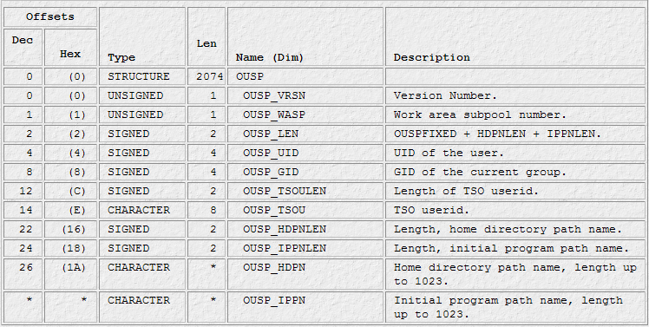
User Security Packet

Slide 19
UID
A numerical representation of a user entity
  Care should be taken in assigning 0 as the user identifier. UID 0 is considered a superuser. The superuser passes all z/OS UNIX security checks.
  Assigning a UID to a user ID that appears in the RACF started procedures table (ICHRIN03) should also be done with care.
  RACF defined started tasks that have the trusted or privileged attribute are considered superusers even if their UID is a value other than 0.
Values range from 0 - 2,147,483,647 (2Gig)
“unique” to each user ID
  May have multiple UID 0 “root” users
  The security administrator controls shared UIDs by defining the SHARED.IDS profile in the UNIXPRIV class.

Slide 20
GID
The GID is a numeric value from 0 – 2,147,483,647.
When a GID is assigned to a group, all users connected to that group who have a user identifier (UID) in their user profile can use functions such as the TSO/E command, OMVS, and can access z/OS UNIX files based on the GID and UID values assigned.
If the security administrator has defined the SHARED.IDS profile in the UNIXPRIV class, the GID must be unique.
The same value can be assigned to multiple groups, but this is not recommended because individual group control would be lost. However, if you want a set of groups to have exactly the same access to z/OS UNIX resources, you might decide to assign the same GID to more than one group.
RACF allows you to define and connect a user to more than 300 groups, but when a process is created or z/OS UNIX group information is requested, only up to the first 300 z/OS UNIX groups are associated with the process or user.
The first 300 z/OS UNIX groups that have GIDs to which a user is connected are used by z/OS UNIX. LISTUSER displays the groups in the order that RACF examines them when determining which of the user's groups are z/OS UNIX groups.

Slide 21
z/OS Unix Security Related Callable Services
The following lists of services are used by the operating system to affect security for z/OS Unix.
These services are called by the z/OS Unix kernel – the OMVS process – as a result of a user or system action .
For example: if a user attempts to open a file, the kernel calls ck_access or IRRSKA00.
  It’s worth noting here that although these are SAF calls, an installed external security manager must be present to handle the operation. The OMVS process will not initialize if an ESM is not installed.
SAF is the target of the IRRSKA00 call. The SAF Router will pass control to the ESM. If the ESM is RACF, that control would got to the IRRRKA00 routine. It is IRRRKA00 which performs the heavy lifting of checking the user’s authority to open the file.

Slide 22
z/OS Unix Related Callable Services
ck_access (IRRSKA00): Check access
ck_file_owner (IRRSKF00): Check file owner
ck_IPC_access (IRRSKI00): Check IPC access
ck_owner_two_files (IRRSC200): Check owner of two files
ck_priv (IRRSKP00): Check privilege
ck_process_owner (IRRSKO00): Check process owner
clear_setid (IRRSCS00): Clear set ID
deleteUSP (IRRSDU00): Delete USP
getGMAP (IRRSGM00): Get GID-to-Group-Name mapping
get_uid_gid_supgrps (IRRSGE00): Get UIDs, GIDs, and supplemental groups
getUMAP (IRRSUM00): Get UID-to-User-ID mapping
initACEE (IRRSIA00): Initialize ACEE
initUSP (IRRSIU00): Initialize USP
makeFSP (IRRSMF00): Make IFSP
makeISP (IRRSMI00): Make IISP
make_root_FSP (IRRSMR00): Make root IFSP
query_file_security_options (IRRSQF00): Query file security options
query_system_security_options (IRRSQS00): Query system security options
R_admin (IRRSEQ00): RACF administration API
R_audit (IRRSAU00): Provide an audit interface
R_auditx (IRRSAX00 or IRRSAX64): Audit a security-related event
R_cacheserv (IRRSCH00): Cache services
R_chaudit (IRRSCA00): Change audit options
R_chmod (IRRSCF00): Change file mode
R_chown (IRRSCO00): Change owner and group
R_datalib (IRRSDL00 or IRRSDL64): OCSF data library
Dotted decimal numbers indicate chapter.section of
z/OS Security Server RACF Callable Services Document Number SA22-7691-09

Slide 23
z/OS Unix Related Callable Services
R_dceauth (IRRSDA00): Check a user's authority
R_dceinfo (IRRSDI00): Retrieve or set user fields
R_dcekey (IRRSDK00): Retrieve or set a non-RACF password
R_dceruid (IRRSUD00): Determine the ID of a client
R_exec (IRRSEX00): Set effective and saved UIDs/GIDs
R_fork (IRRSFK00): Fork a process
R_GenSec (IRRSGS00 or IRRSGS64): Generic security API interface
R_getgroups (IRRSGG00): Get/Set supplemental groups
R_getgroupsbyname (IRRSUG00): Get groups by name
R_GetInfo (IRRSGI00): Get security server fields
R_IPC_ctl (IRRSCI00): Perform IPC control
R_kerbinfo (IRRSMK00): Retrieve or set security server network authentication service fields
R_PKIServ (IRRSPX00): Request public key infrastructure (PKI) services
R_proxyserv (IRRSPY00): LDAP interface
R_ptrace (IRRSPT00): Ptrace authority check
R_setegid (IRRSEG00): Set effective GID, set all GIDs
R_seteuid (IRRSEU00): Set effective UID, set all UIDs
R_setfacl (IRRSCL00):Unix access control lists
R_setfsecl (IRRSSB00): Security label
R_setgid (IRRSSG00): Set group name
R_setuid (IRRSSU00): Set z/OS UNIX user identifier (UID)
R_ticketserv (IRRSPK00): Parse or extract
R_umask (IRRSMM00): Set file mode creation mask
R_usermap (IRRSIM00): Map application user
R_writepriv (IRRSWP00): Write-down privilege

Slide 24
Summary
z/OS Unix System Services manages security through SAF and an external security manager.
Internally, security contexts are identical to those used by legacy processes
z/OS is a Unix branded operating system so the external security concepts are Unix based
UIDs can be shared on z/OS

